Slide 1
Quick Copy
Progress Report
Group Members:
Jyothi K - 4MT22AI019
Medha R - 4MT22AI025
Omkar S Bhute - 4MT22AI033
Swapna Hande D - 4MT22AI057

Slide 2
Abstract
Print shops on campus face long queues and congestion, causing delays for students and inefficiencies for staff.
Our mobile app introduces virtual queuing, allowing students to reserve their spot, upload files, and get real-time updates.
Reduces physical wait times, improves print shop operations, and enhances the user experience.
A faster, more efficient system for managing print tasks, benefiting both students and staff.

Slide 3
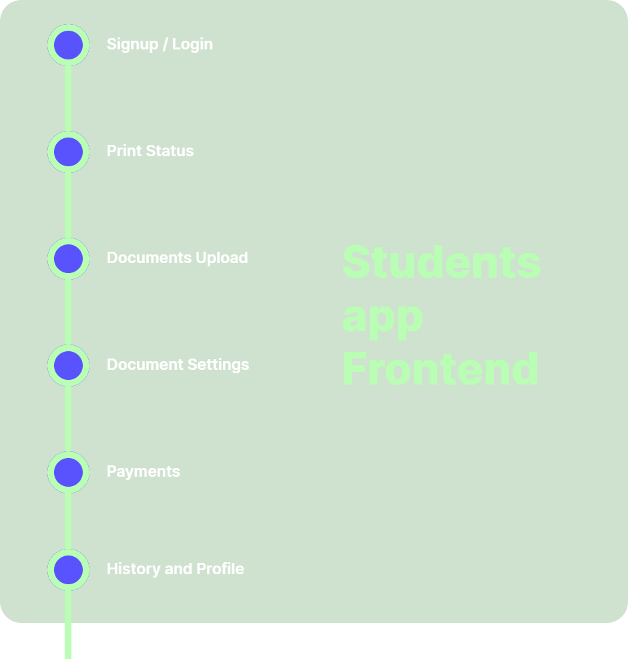
Progress

Slide 4
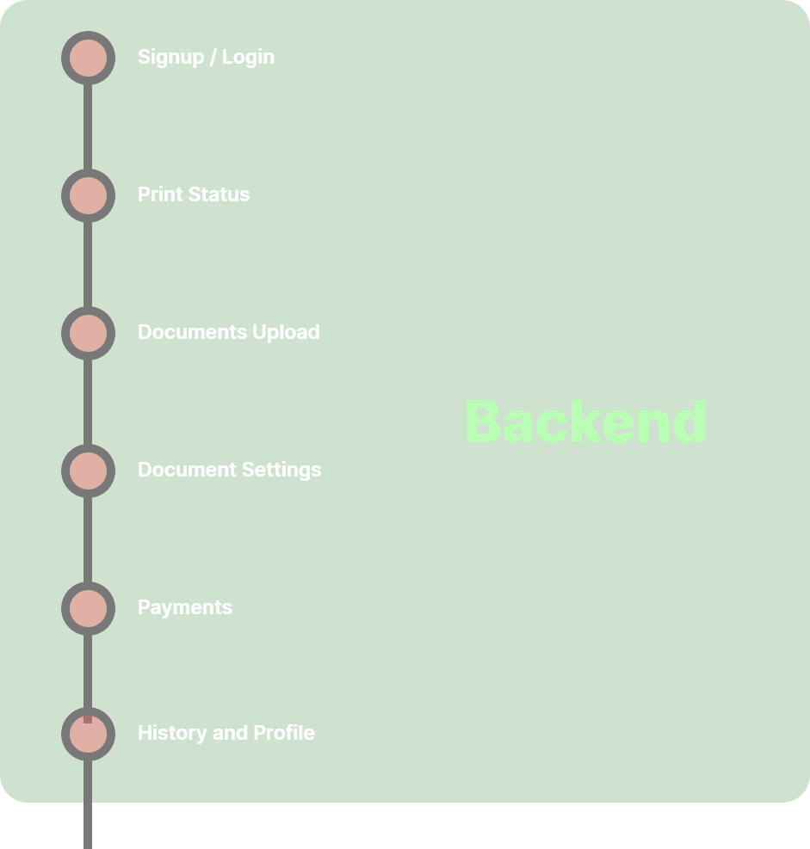
Progress

Slide 5
Students App Demo

Slide 6
Classed Based Model
Student
Attributes: studentID, name, email, phoneNumber
Methods: reserveQueue(), uploadFile(), checkQueueStatus()
Queue
Attributes: queueID, studentList, position, estimatedWaitTime
Methods: addStudentToQueue(), updateQueueStatus(), removeStudent()
File
Attributes: fileID, fileName, fileType, fileSize, uploadTimestamp, studentID
Methods: upload(), validateFileFormat()
Notification
Attributes: notificationID, type, message, timestamp, studentID
Methods: sendNotification(), updateStatus()
PrintShopStaff
Attributes: staffID, name, email, assignedQueue
Methods: viewQueueStatus(), manageQueue(), confirmPrintJob()
PrintJob
Attributes: jobID, fileID, studentID, status, timeSubmitted
Methods: createJob(), updateJobStatus(), completeJob()

Slide 7
Thank You

